Slide 1
Vascular disorders of the liver
Muntadher Abdulkareem Abdullah
Gastroenterologist and hepatologist

Slide 2
Vascular liver disorders include:
Portal vein thrombosis
Hepatic artery diseases (aneurysm, thrombosis)*
Sinusoidal obstruction syndrome
Radiation-induced liver disease*
Peliosis hepatis and sinusoidal dilatation*
Budd-Chiari syndrome
Congenital vascular malformations

Slide 3
Portal Vein Thrombosis
Obstruction of the portal vein or its branches can be related to invasion or constriction by a malignant tumor, or to thrombosis.
From a clinical point of view, PVT consists of two different entities, acute PVT and chronic PVT, which represent successive stages of the same disease and share similar causes but differ as to their management.

Slide 5
Causes of Portal Vein Thrombosis
PVT is caused by a combination of local and general risk factors.
Local Factors : 30 %
Malignant tumors and cirrhosis are the leading local factors
A local factor for PVT is more frequently recognized at the acute stage of PVT

Slide 6
Cancer
Any abdominal organ
Focal inflammatory lesions
Neonatal omphalitis, umbilical vein catheterization, Diverticulitis, Appendicitis, Pancreatitis
Injury to the portal venous system
Splenectomy, Colectomy, Gastrectomy
Cirrhosis

Slide 7
General Factors
similar in nature and in prevalence in patients with acute PVT and chronic PVT

Slide 8
Myeloproliferative disorders
Atypical
Classical
Antiphospholipid syndrome
Paroxysmal nocturnal hemoglobinuria
Behcet’s disease
Factor V Leiden mutation Factor II mutation
Protein C deficiency* Protein S deficiency*
Antithrombin deficiency* Plasminogen deficiency*
Recent pregnancy Recent oral contraceptive use
Hyperhomocysteinemia
TT677 MTHFR genotype

Slide 9
Acute Portal Vein Thrombosis
Definition.:
Acute PVT is characterized by the sudden formation of a thrombus within the portal vein.
The thrombus can involve a variable portion of the mesenteric veins and/or the splenic vein.
Occlusion can be complete, or it can be partial.
Acute septic PVT is frequently referred to as acute pylephlebitis

Slide 10
Clinical and Laboratory Features
Abdominal or lumbar pain of sudden onset or progressing over a few days.
The abdomen might be moderately distended by ileus, but without any other features of intestinal obstruction
There is no guarding, except when an inflammatory focus is the cause for PVT or when PVT is complicated with intestinal infarction
Partial thrombosis might be associated with fewer symptoms.
Rapid and complete obstruction of the portal vein or mesenteric veins, without involvement of mesenteric venous arches, induces intestinal congestion, manifested by severe continuous colicky abdominal pain and occasionally nonbloody diarrhea.

Slide 11
Persistent, nonspiking fever
Clinical features that suggest a patient has transmural intestinal ischemia(obstruction of venous outflow ) include:
persistence of severe pain beyond 5-7 days, bloody diarrhea, and ascites.
Acidosis and renal or respiratory dysfunction are also suggestive of intestinal infarction.
In the absence of treatment, intestinal perforation, peritonitis, shock, and death from multiorgan failure occur.
Clinical features of pylephlebitis include a high, spiking fever with chills, painful liver and sometimes shock.

Slide 12
Investigations
General investigations :
CBC
LIVER FUNCTION TEST
RENAL FUNCTION TEST
COAGULATION PROFILE
CRP , ESR
BLOOD CULTURE

Slide 13
Imaging Features and Diagnosis.
Abdominal ultrasound with doppler
CT abdominal angiography
MR angiography

Slide 14
Treatment
The goal of treatment of acute PVT is to recanalize the obstructed veins, which will prevent intestinal infarction and portal hypertension, Correction of the causal factors,
Anticoagulation therapy : 3-6 months of anticoagulation therapy was associated with complete recanalization in 50% of patients
Start with low molecular weight heparin in order to achieve rapid anticoagulation. Shift to oral anticoagulation as soon as the patient’s condition has stabilized, when no invasive procedure is planned
permanent anticoagulation therapy be considered for patients with permanent prothrombotic conditions.
When clinical and radiological features indicate that a patient has intestinal infarction, emergency laparotomy for resection of the overtly necrotic parts of the gut should be performed.

Slide 15
Chronic Portal Vein Thrombosis
known as portal cavernoma
Clinical and Laboratory Manifestations
hypersplenism or portal hypertension.
Biliary symptoms related to portal cholangiopathy (jaundice, biliary pain, cholangitis, cholecystitis, or pancreatitis) rarely reveal a cavernoma.
Gastrointestinal bleeding .
ascites or encephalopathy are uncommon
Liver tests are typically normal in patients with portal cavernoma in the absence of underlying liver disease.
Coagulation factor levels can be moderately altered.
Portal cholangiopathy should be considered when there are cholestatic features.
Hepatopulmonary syndrome is present in about 10% of patients

Slide 16
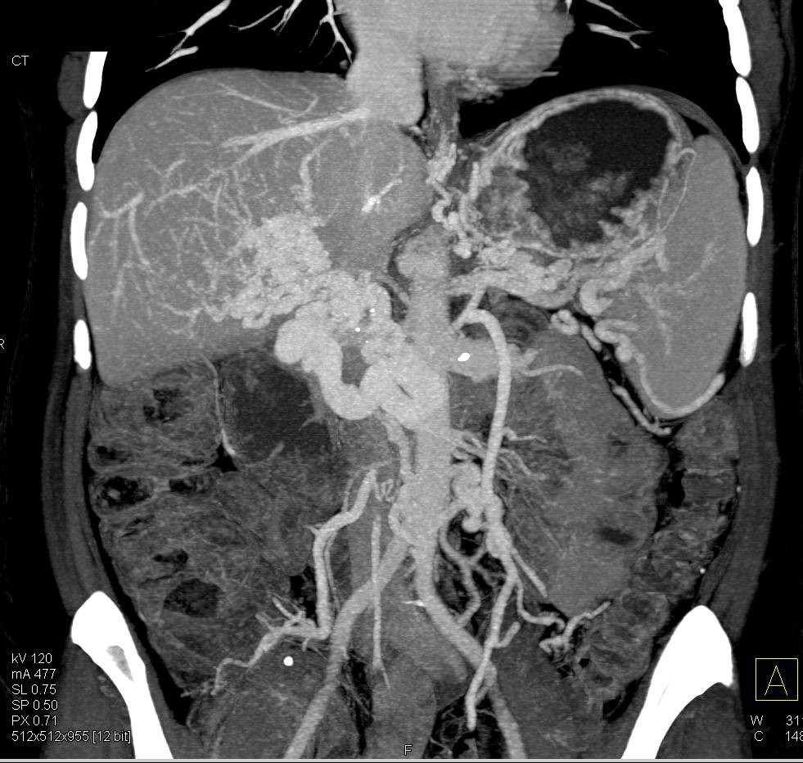

Slide 17
Diagnosis.
Abdominal imaging with abdominal ultrasound with colour doppler
CT abdominal angiography
MR angiography

Slide 18
Treatment
Therapy for chronic PVT can be separated into three areas:
prevention and treatment of gastrointestinal bleeding
prevention of recurrent thrombosis
treatment of portal cholangiopathy.

Slide 19
Sinusoidal Obstruction Syndrome (Hepatic Venoocclusive Disease)
occurs most commonly as a complication of myeloablative regimens that are used to prepare patients for hematopoietic stem cell transplantation
Other causes of SOS include chemotherapeutic agents at more conventional doses, chronic immunosuppression with azathioprine or 6-thioguanine, and ingestion of herbal teas made with pyrrolizidine alkaloids or food sources contaminated pyrrolizidine alkaloids.

Slide 20
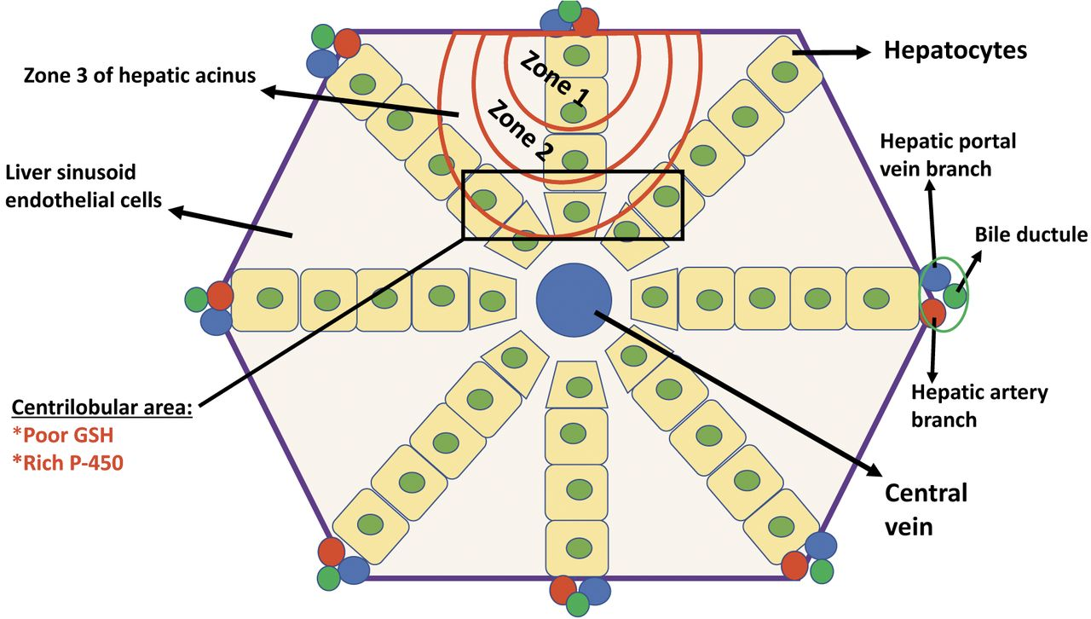

Slide 21
Diagnosis
In the context of typical history , the diagnosis of SOS can be aided by :
The presence of Tender hepatomegaly, fluid retention and weight gain, and elevated serum bilirubin
Rule out other common causes of jaundice
Image the liver with Doppler ultrasound or another modality to rule out other causes and to demonstrate features consistent with SOS
The major strategy for preventing SOS is identification of patients with risk factors for toxic liver injury and avoidance of liver-toxic conditioning regimens in these patients.

Slide 22
Budd-Chiari Syndrome
hepatic venous outflow tract obstruction independent of the level or mechanism of obstruction.
Cardiac and pericardial diseases and sinusoidal obstruction syndrome are excluded from this definition.

Slide 23
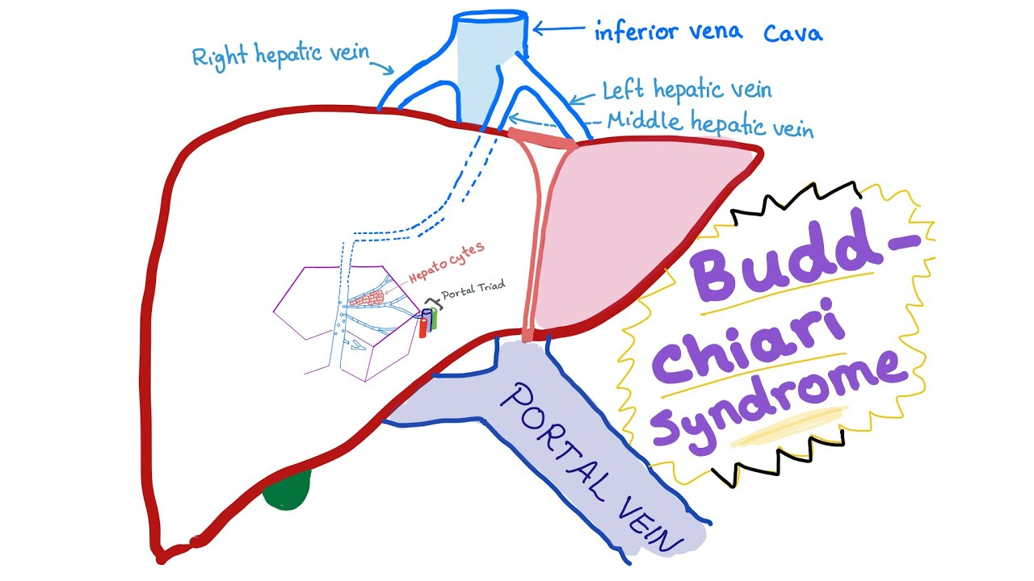

Slide 24
Causes.
BCS is divided into :
“secondary” BCS when related to compression or invasion by a lesion originating outside the veins (benign or malignant tumor,
abscess, cyst, etc.); and “primary” BCS when related to a primarily venous disease (thrombosis or phlebitis)
Secondary Budd-Chiari Syndrome. Hepatocellular carcinoma, renal and adrenal adenocarcinoma, primary hepatic hemangiosarcoma, epithelioid hemangioendothelioma, sarcoma of the IVC, right atrial myxoma, and alveolar hydatid disease may cause BCS through invasion of the venous outflow
Primary Budd-Chiari syndrome:
Overall, an underlying risk factor for thrombosis is found in up to 87% of patients with BCS. A combination of several causal factors is demonstrated in about
25% of patients,

Slide 25
Clinical and Laboratory Features
Presentation ranges from complete absence of symptoms to fulminant hepatic failure, through acute (rapid) or chronic (progressive) development of symptoms over weeks to months before diagnosis is made.
Classical signs and symptoms of BCS include fever, abdominal pain, ascites, lower extremity edema, gastrointestinal bleeding, and hepatic encephalopathy, each of which may be absent in patients with overt BCS.
Jaundice is relatively uncommon.
Marked dilation of subcutaneous veins on the trunk has a high specificity but a low sensitivity for IVC block.
Serum aminotransferases and alkaline phosphatase can be normal or increased. Levels of serum albumin, serum bilirubin, and prothrombin can be normal or abnormal, and in some patients are markedly abnormal.

Slide 26
serum-ascites albumin concentration gradient >= 1.1 g/dL and protien concentration in ascitic fluid above 3 g/dl are suggestive of BGS , cardiac disease, or pericardial disease.
Serum creatinine level can be elevated, usually due to prerenal dysfunction.
The course of these manifestations can be steadily progressive or marked by exacerbations and remissions.
The disease can run a long insidious course, or a short period of prodrome followed by a rapid downhill course.
Portal venous obstruction is common in patients with severe forms of the disease.

Slide 27
Imaging Features
X-ray Venography Has Been The Gold Standard For The Evaluation Of The Hepatic Veins.
ABDOMINAL ULTRASOUND WITH DOPPLER STUDY
CT ABDOMINAL ANGIOGRAPHY
MR ANGIORAPHY
Caudate lobe hypertrophy is found in about 75% of patients.

Slide 28
Therapy
Medical Therapy
Underlying Risk Factors for Thrombosis. Oral contraceptives are generally contraindicated in patients with BCS
Anticoagulation Therapy
Thrombolysis: LIMITED ROLE
Medical Treatment for Portal Hypertension.
Angioplasty and Stenting.
Liver Transplantation : FULMINANT HEPATIC FAILURE

Slide 29
THANKS

